Slide 1
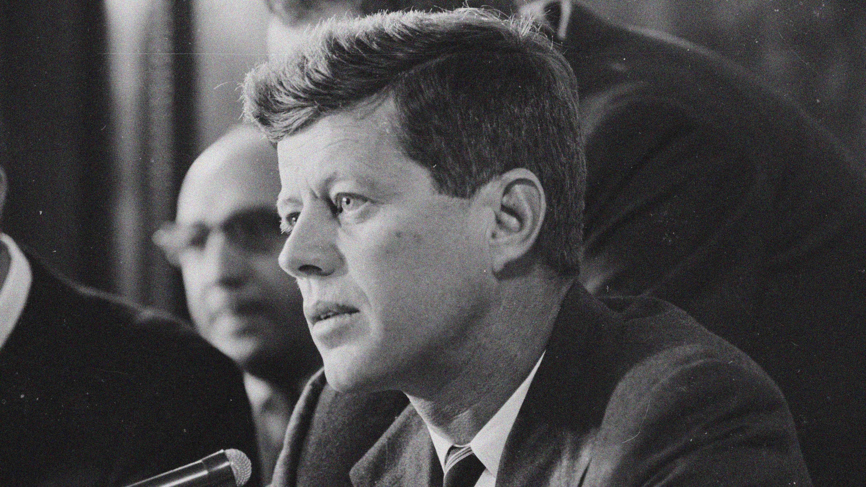
“The future is not a gift,
it's an achievement.”
- Robert F. Kennedy-

Slide 2
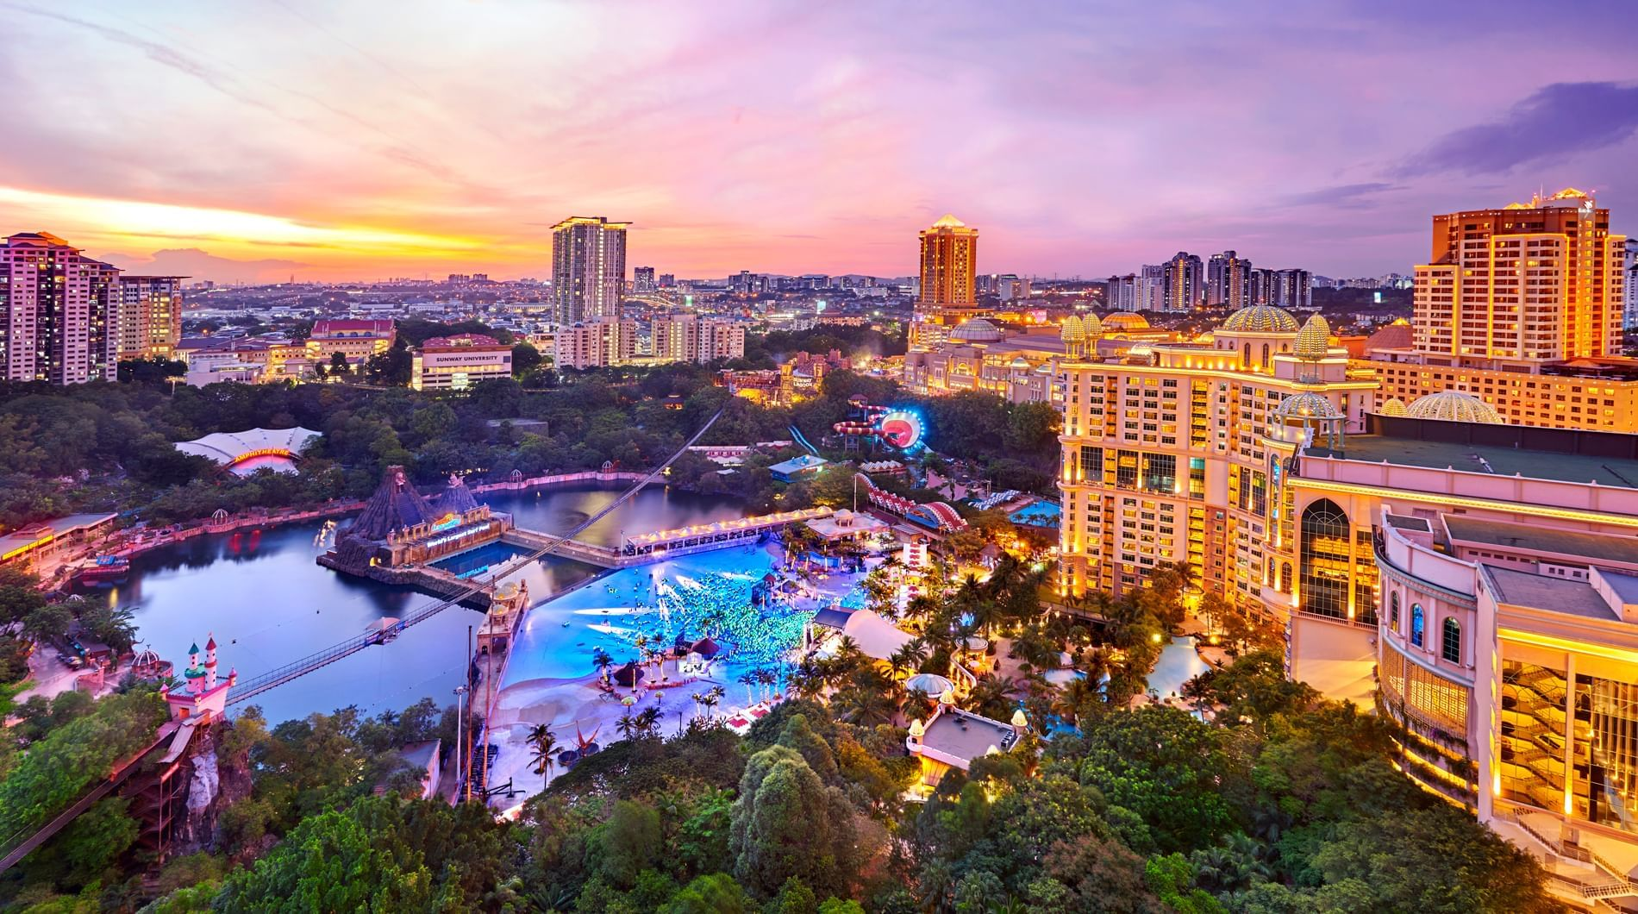

Sunway Digital
Competition
GEEKHUB
GEEKHUB
GEEKHUB
9.9.2023
Presented by:
Adi Muadz Hilman

Slide 3

SCAN HERE
SUNWAY SDG
INITIATIVES
SHOWCASE
https://sdc-wa-geekhub.netlify.app/

Slide 4
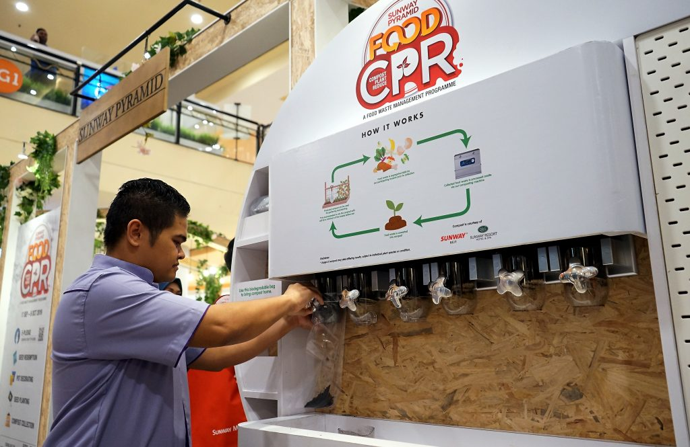


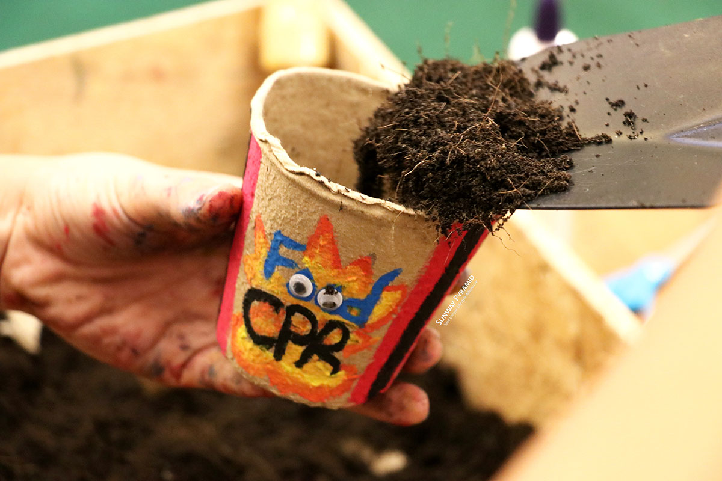
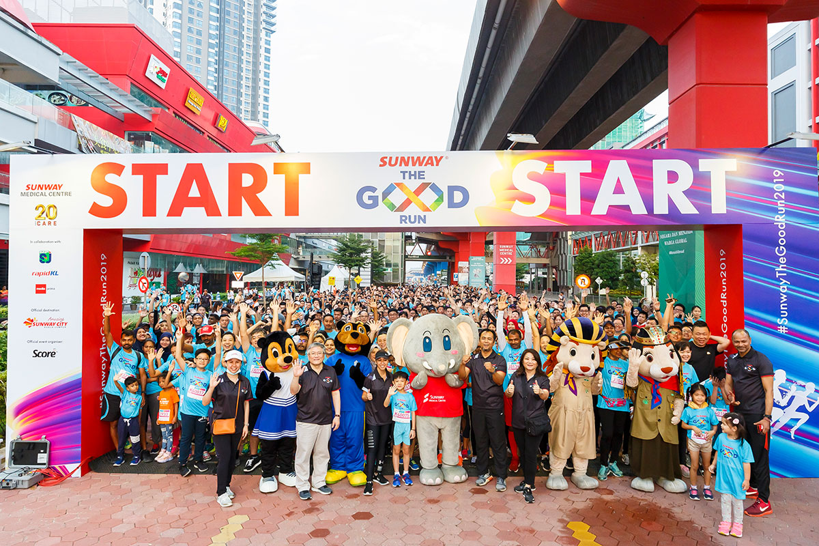
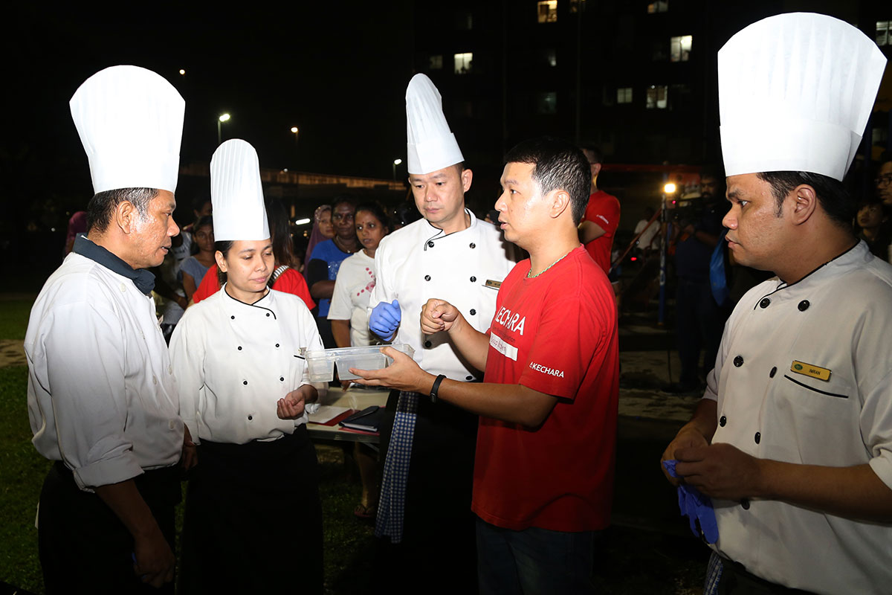
INITIATIVES

Slide 5
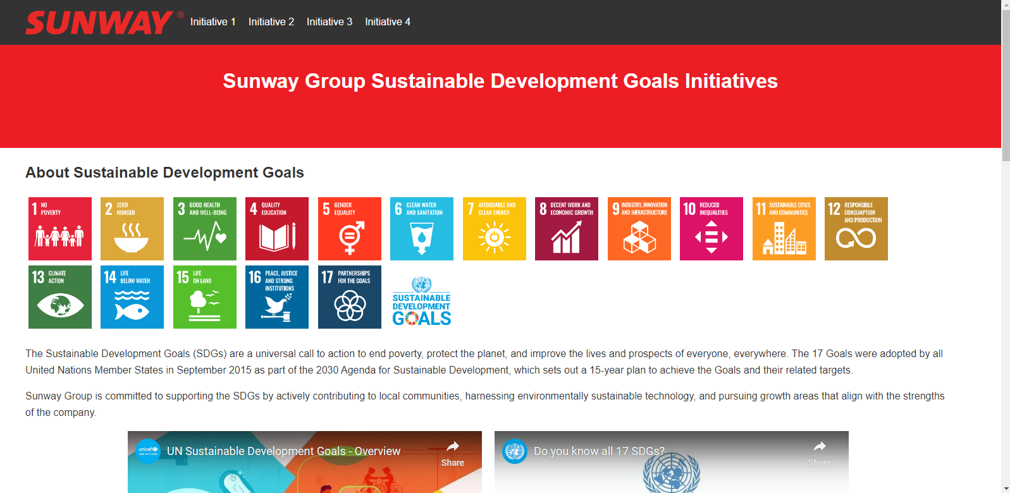
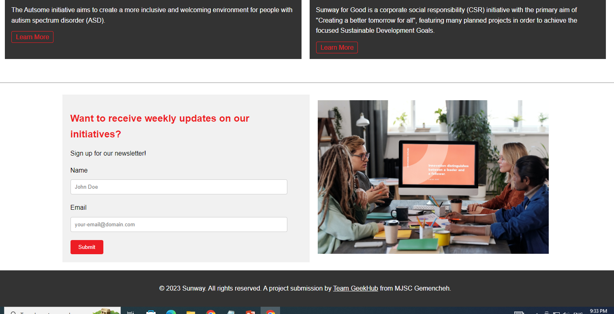
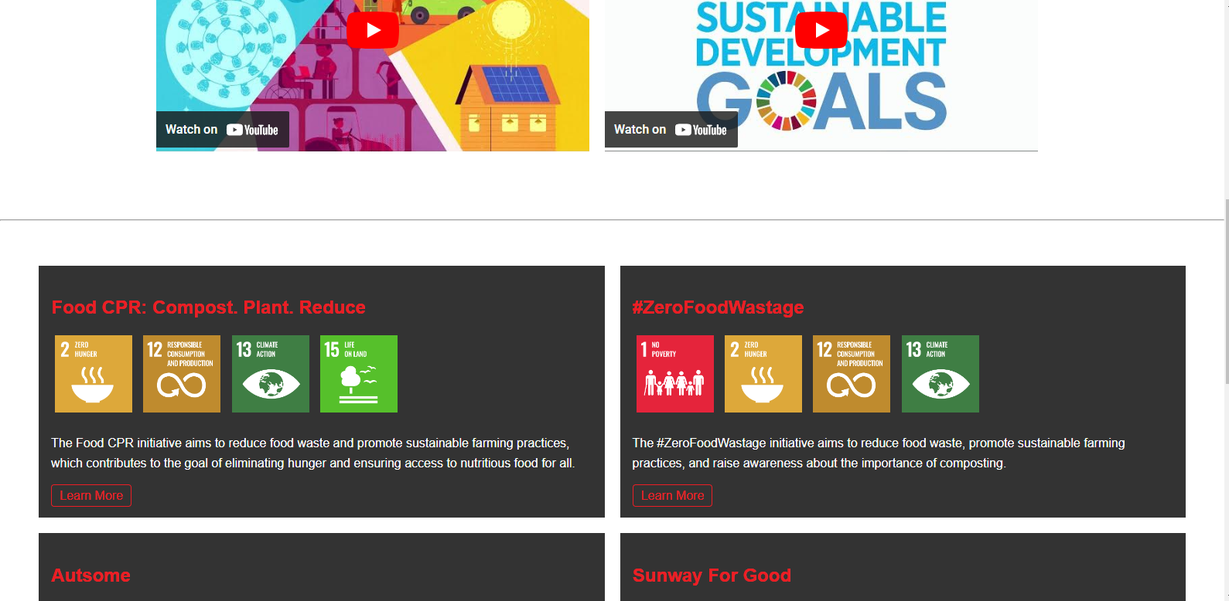
THE WEBSITE

Slide 6
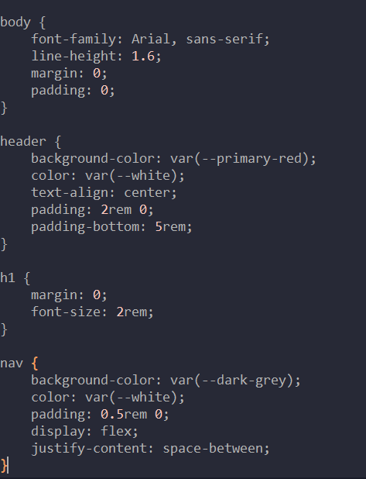
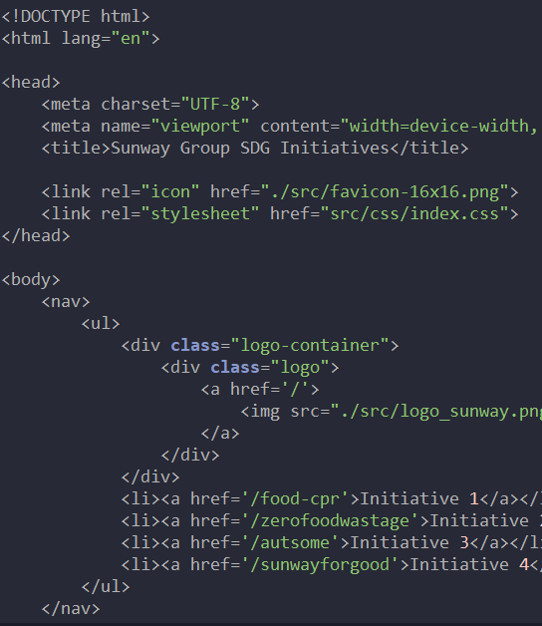
HTML
CSS
HYPERTEXT MARKUP LANGUAGE
CASCADING STYLE SHEETS

Slide 7

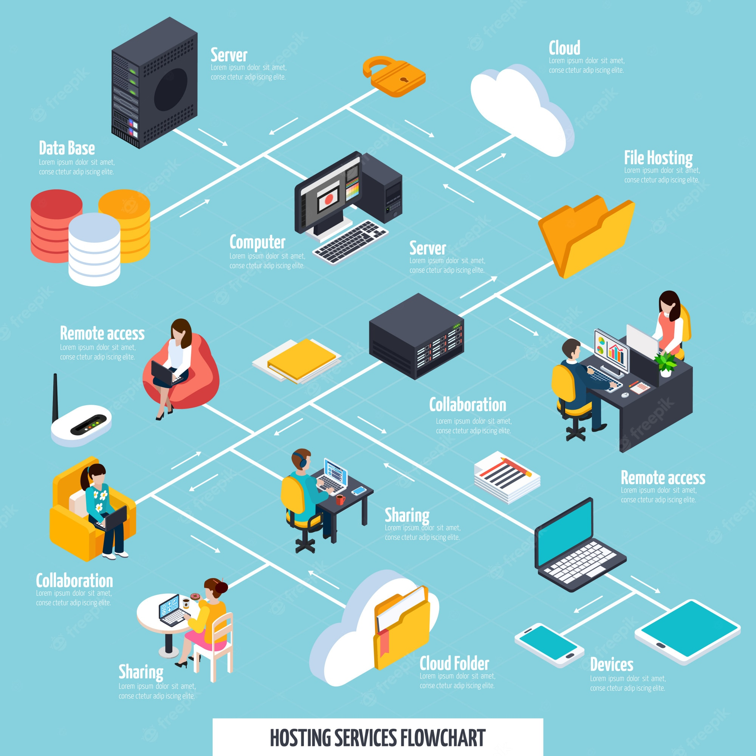

Slide 8
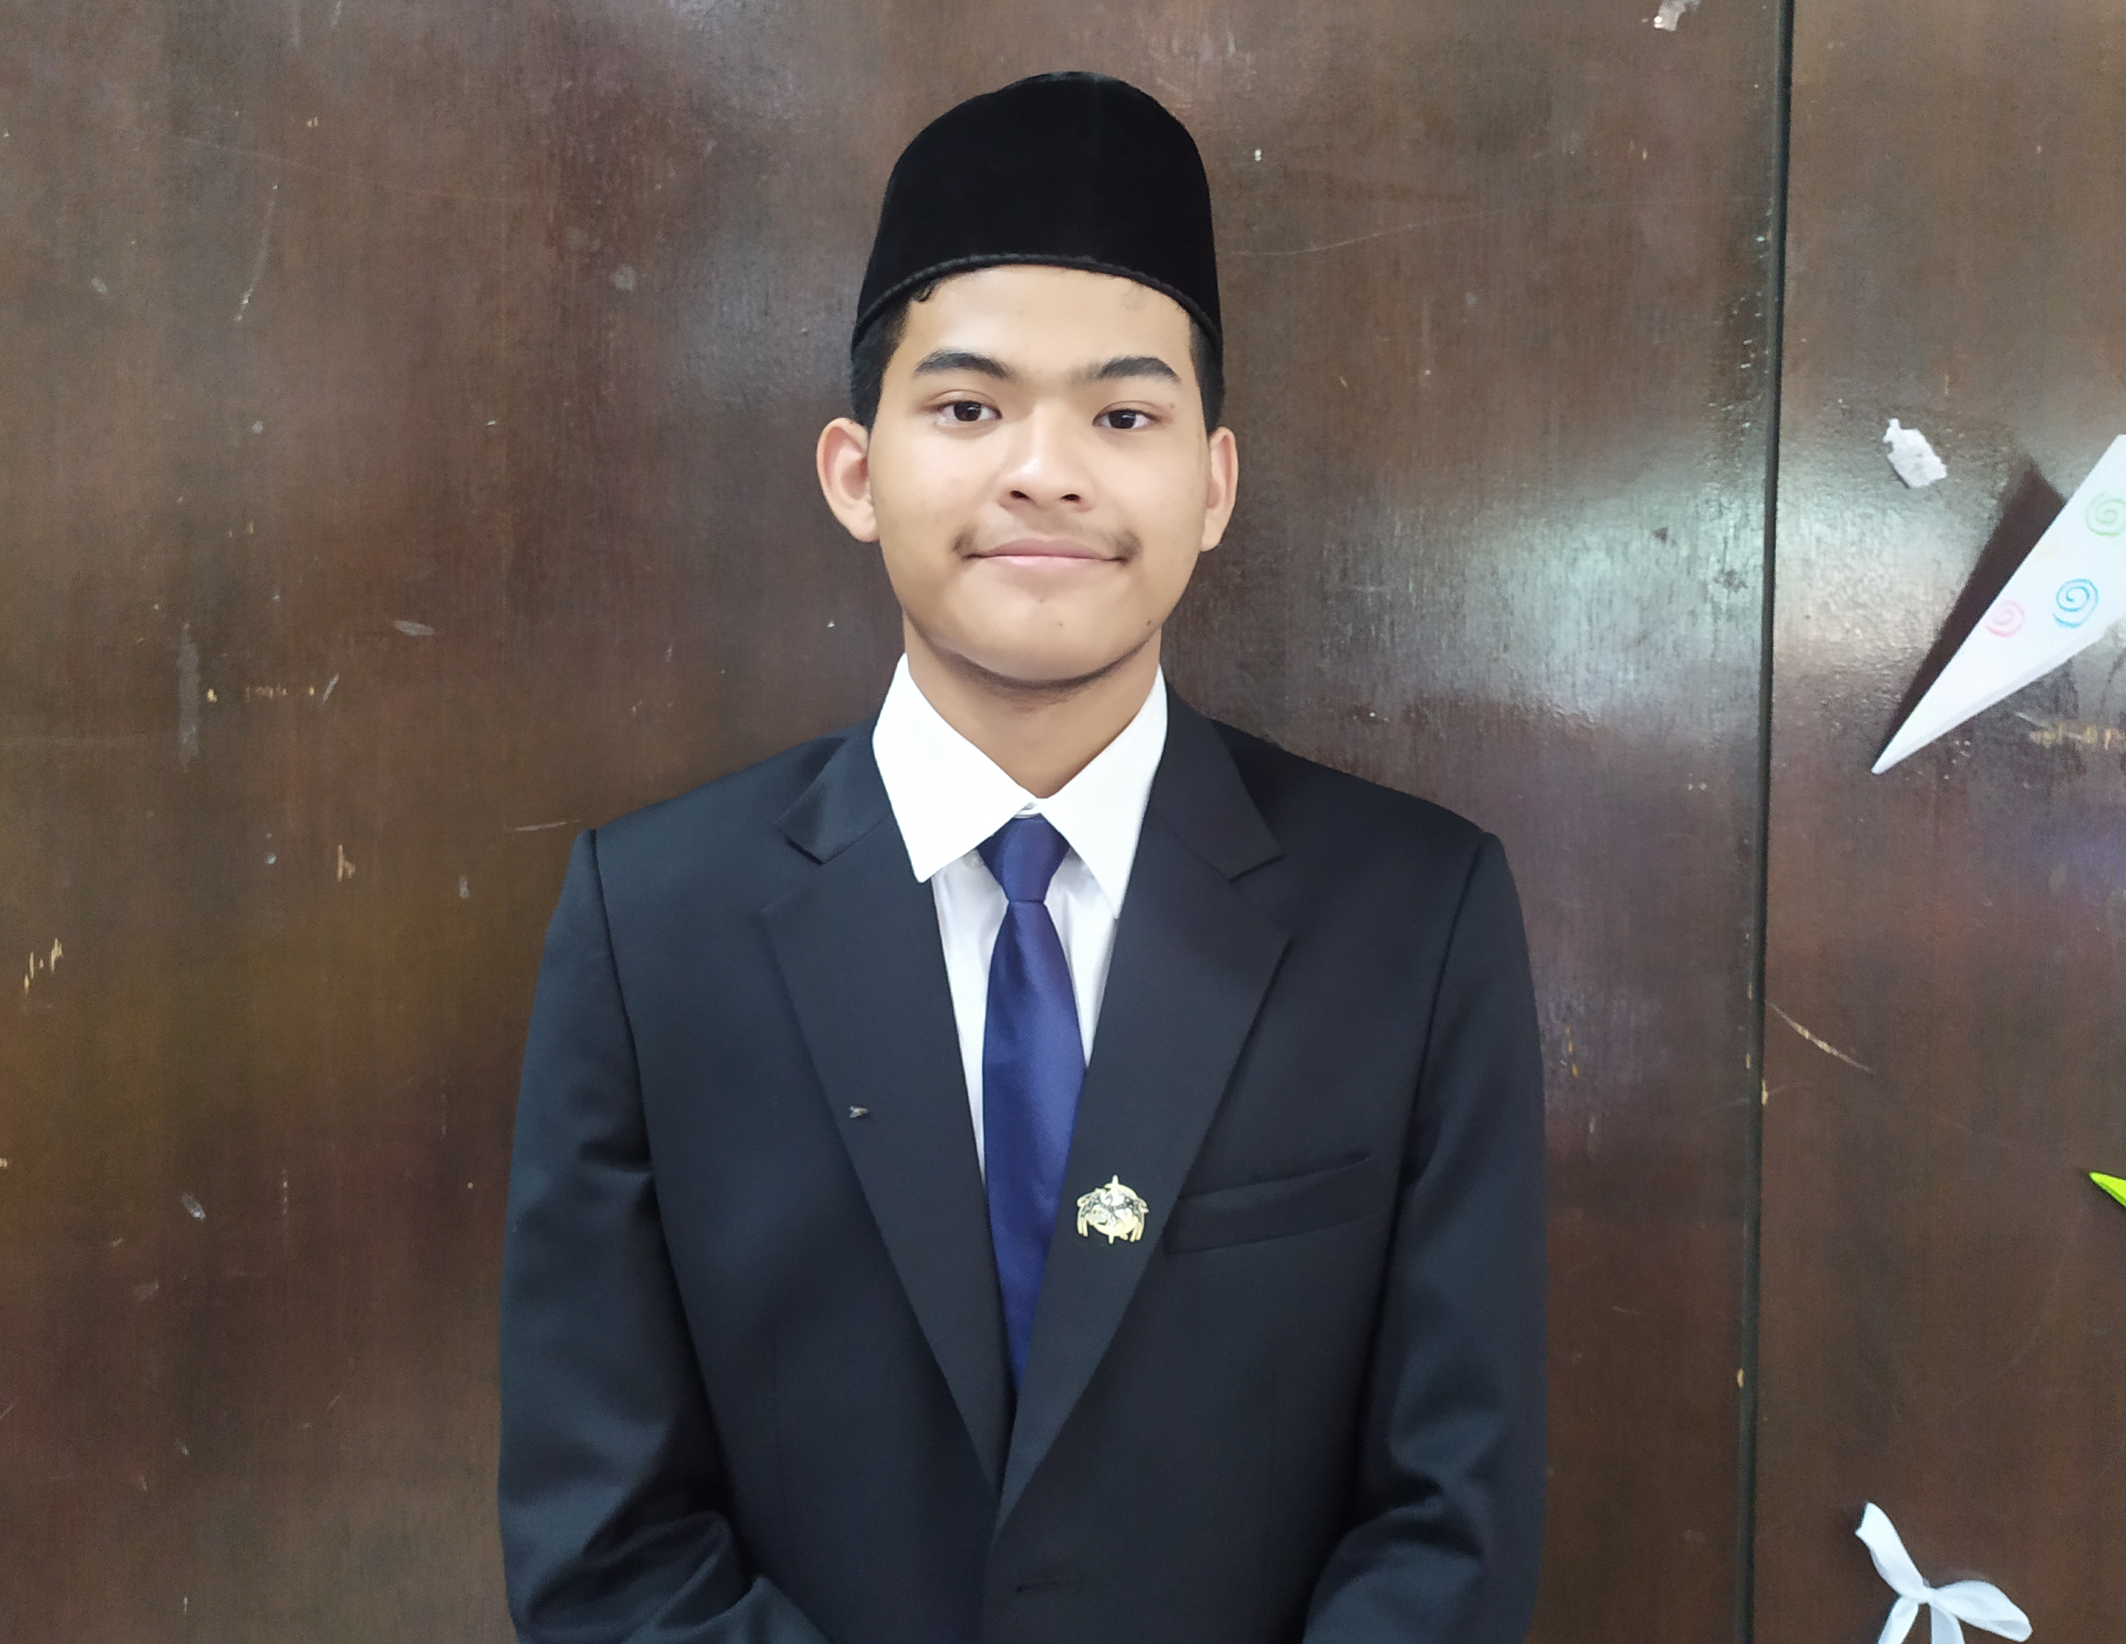
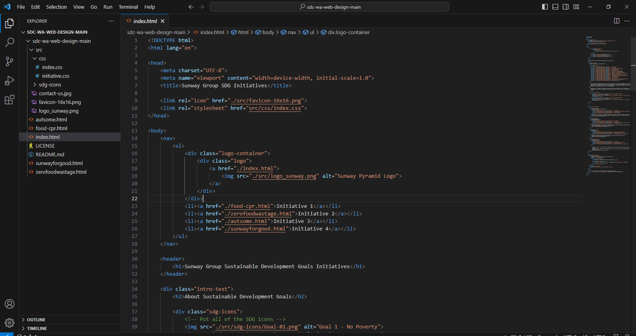

Slide 9
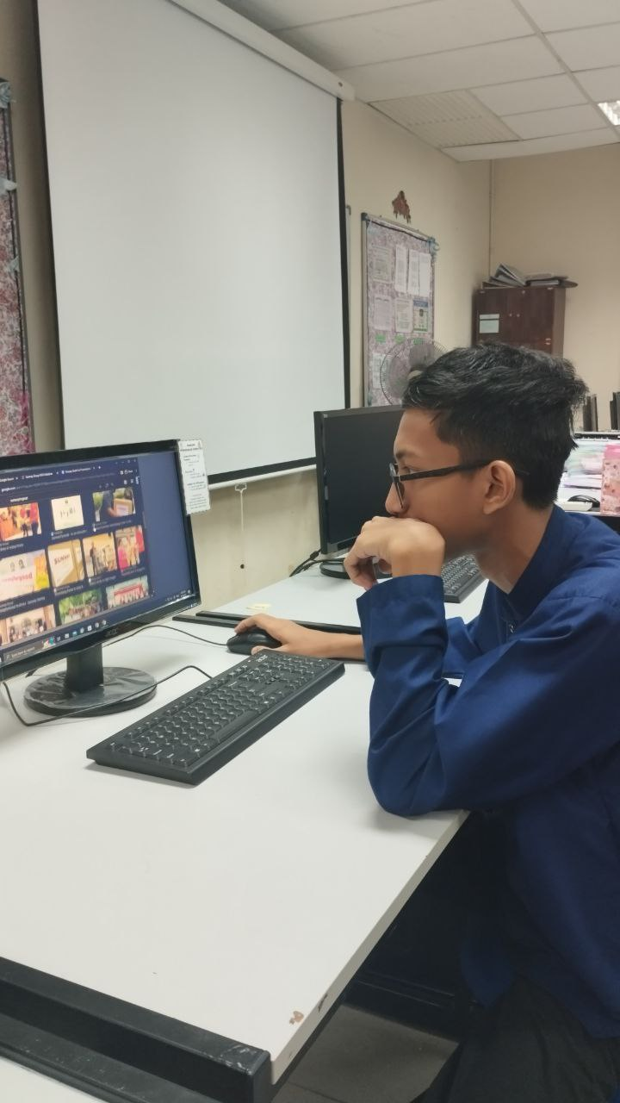
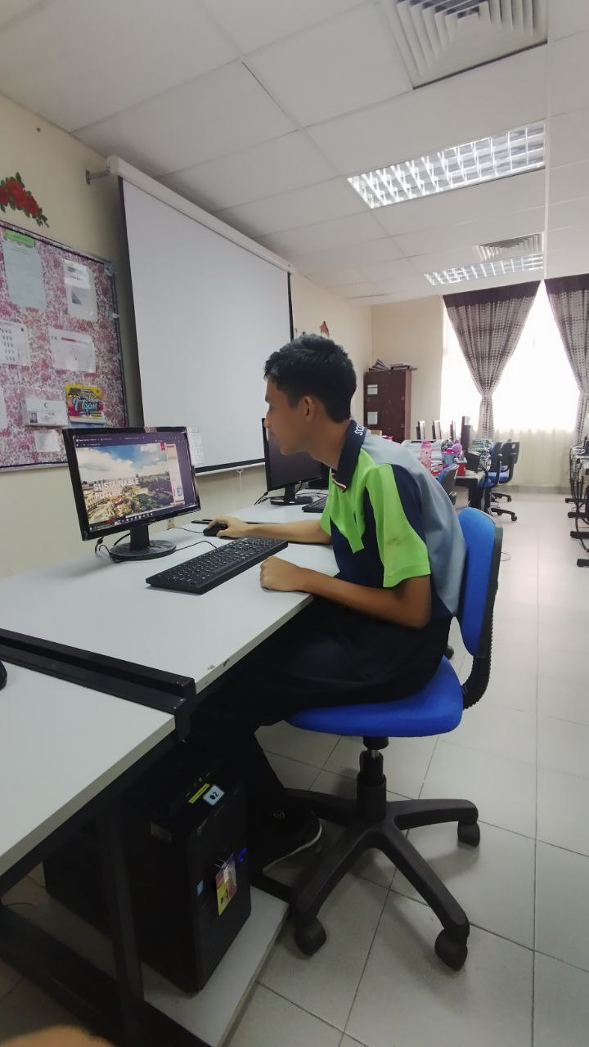

Slide 10
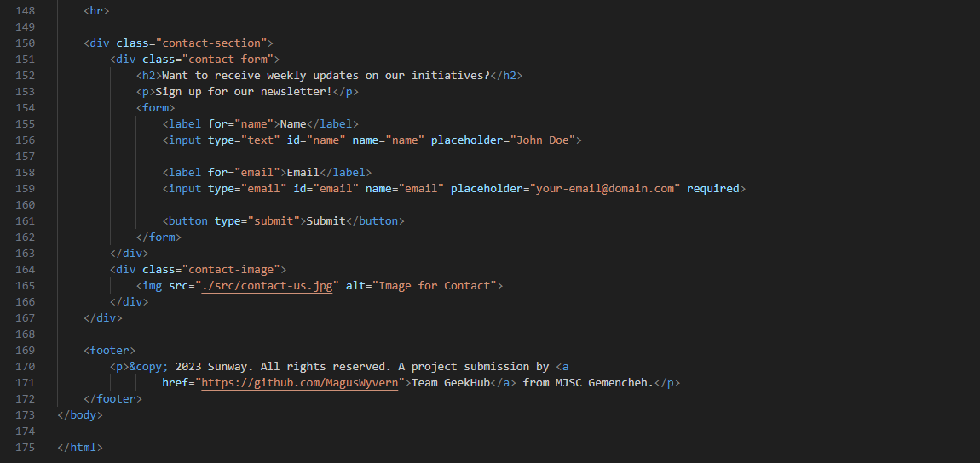
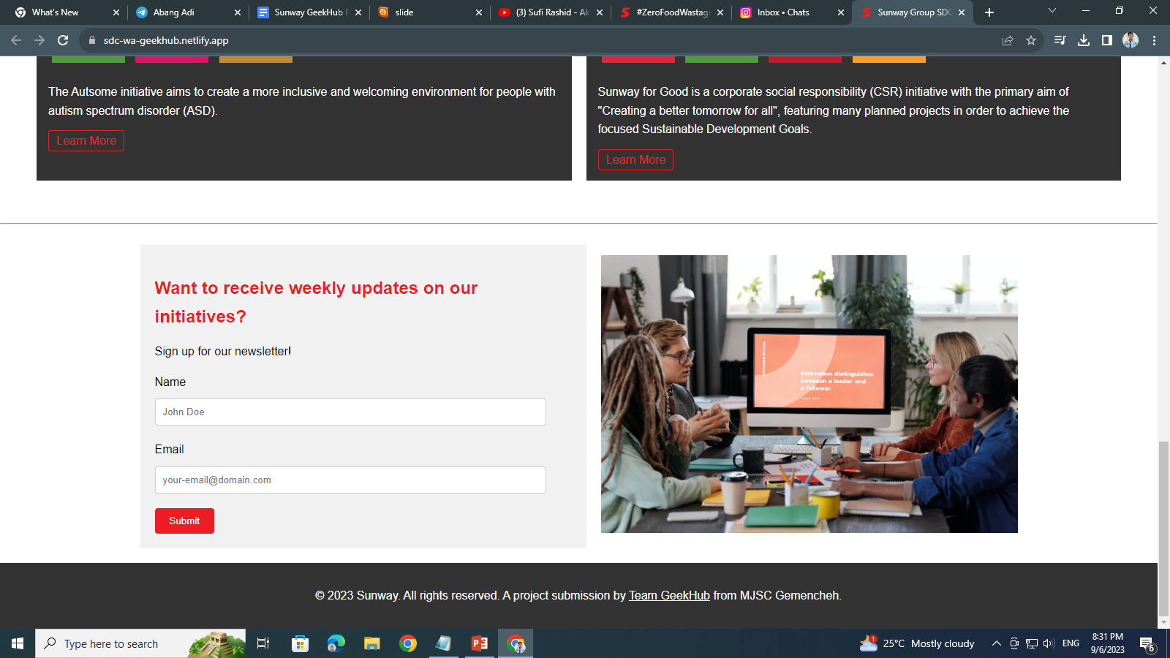
KEEP IN TOUCH WITH US
👋

Slide 11

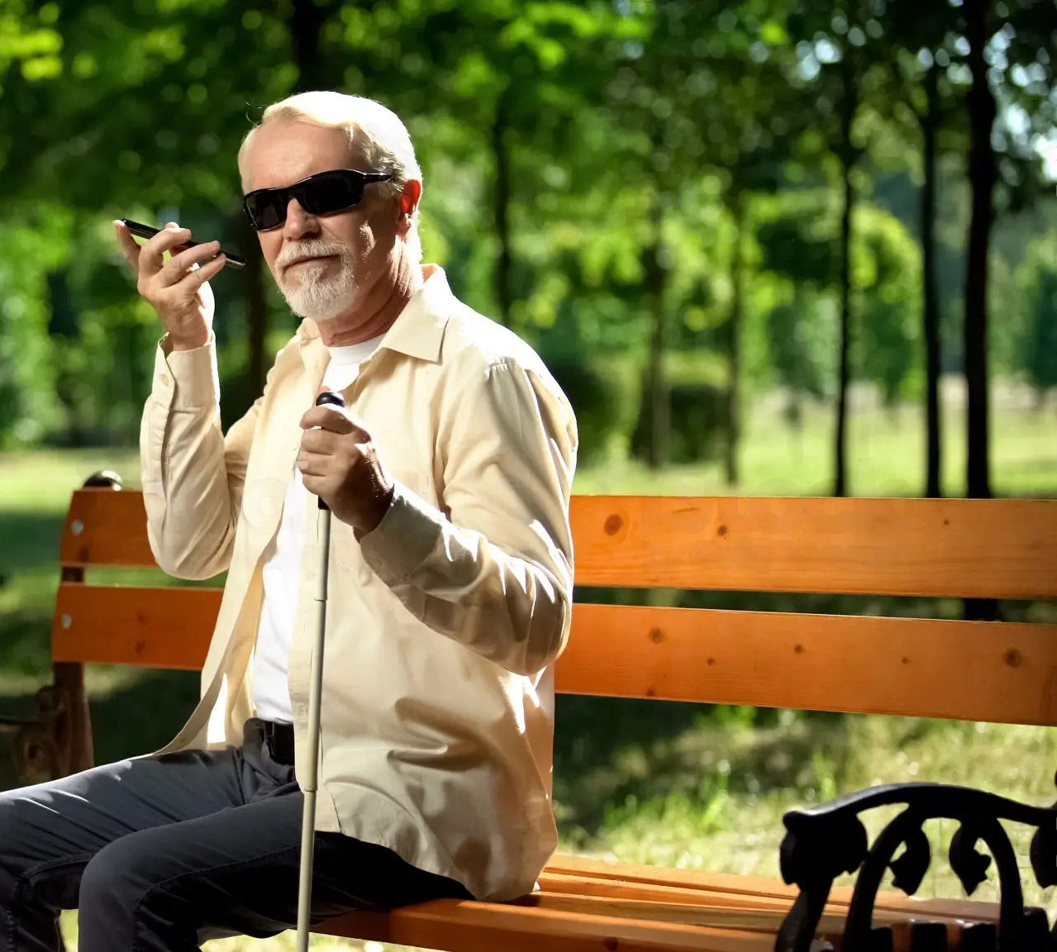

Slide 12
#
<html>
?
question
📱
SUNWAY
how?
Q&A
🖳
🖮
🖰
🙋
answer
CSS

Slide 13
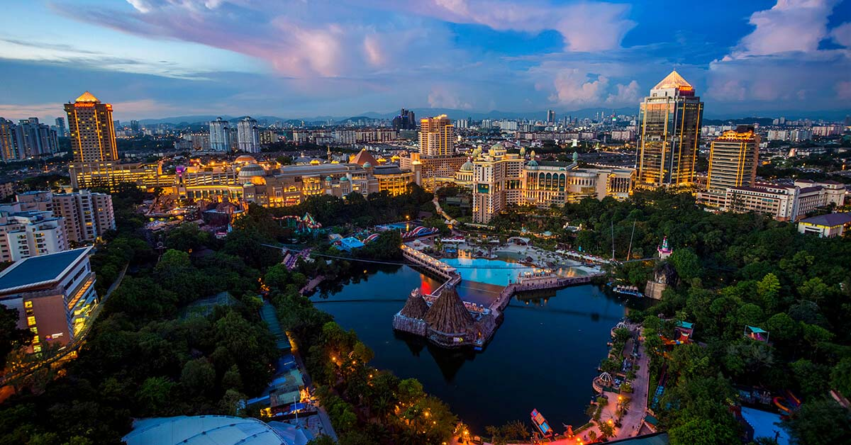
THANK YOU

